Slide 1
Classroom Finder Web Application
Subtitle: An Easy & Efficient Way for Students and Faculty to Locate Classrooms
Project Team Members:
1. P.Vara prasad:2403A51006
2. K.Rakesh Reddy:2403A51010
3.T.Vardhan Bhrami:2403A51024

Slide 2
Introduction:
What is Classroom Finder? A web-based application designed to help students and faculty easily locate their designated classrooms within a campus building or institution.
Purpose:
Reduce confusion and delay in finding classrooms
Provide separate login interfaces for students and faculty
Improve campus navigation efficiency

Slide 3
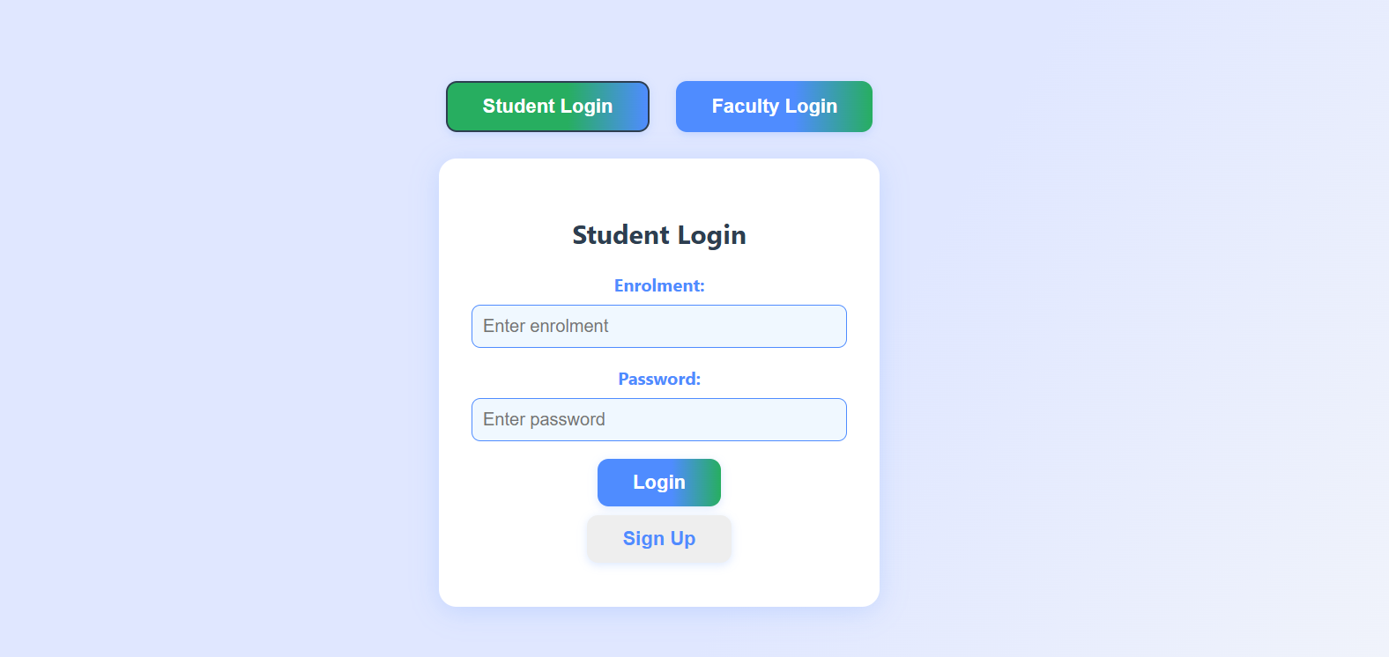
User Interface - Student Login
Student Login Page Features:
Student Login :
Input fields:
Enrolment number
Password
Buttons:
Login (Green-Blue Gradient)
Sign Up (Disabled-looking initially)
Toggle between Student and Faculty login at the top
Technologies Used:
HTML, CSS, possibly JavaScript for interaction

Slide 4
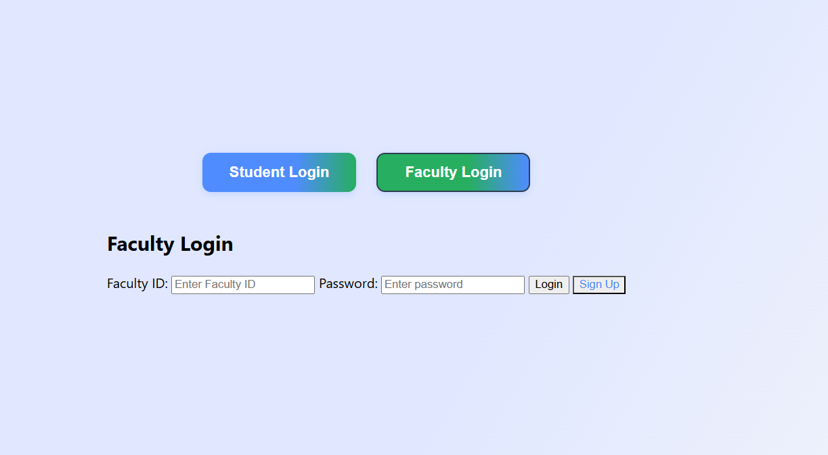
User Interface - Faculty Login
Faculty Login Page Features:
Faculty Login:
Input fields:
Faculty ID
Password
Buttons:
Login
Sign Up
Simple layout with focus on functionality
Login toggle remains accessible
Note: Less stylized than the student interface;
could be improved for consistency

Slide 5
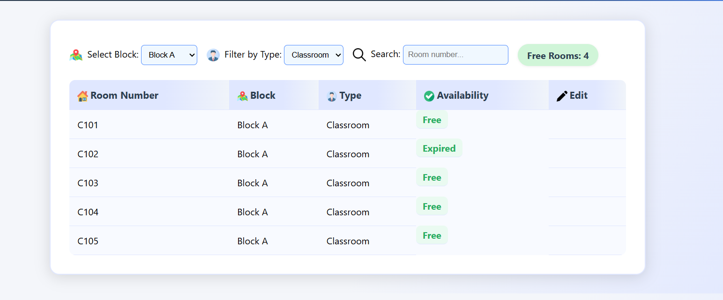
Title: Student Dashboard – After Login
After logging in, students are taken to a dashboard that displays real-time classroom availability. The interface allows users to select a specific block (like Block A, B, C, or D) using a dropdown menu. Students can also filter rooms by type, such as “Classroom”, “Lab”, etc. A search bar is available to quickly locate rooms by entering the room number. The dashboard shows the total number of free rooms in the selected block. All room details are presented in a neat table format with columns: Room Number, Block, Type, and Availability.

Slide 6
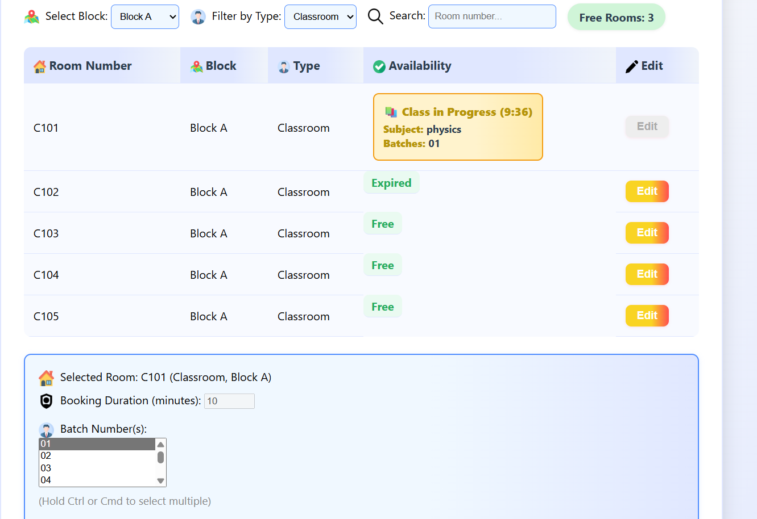
🧑‍🏫 Faculty Room Booking Interface Overview
This is the Faculty Room Booking Interface, designed to help faculty members view and manage classroom bookings efficiently. Faculty can filter rooms by block and room type (e.g., Classroom), and search by room number to quickly locate available rooms. The availability of each room is clearly displayed as Free, Expired, or Class in Progress, along with subject and batch details.
Rooms that are currently occupied cannot be booked until the session ends. To book a room, the faculty selects a room, enters the booking duration (in minutes), and chooses the batch number(s) from the list. Multiple batches can be selected using the Ctrl or Cmd key.
This interface helps avoid booking conflicts and ensures smooth scheduling by providing a real-time view of classroom status. It is a user-friendly system that simplifies room allocation for academic sessions.

Slide 7
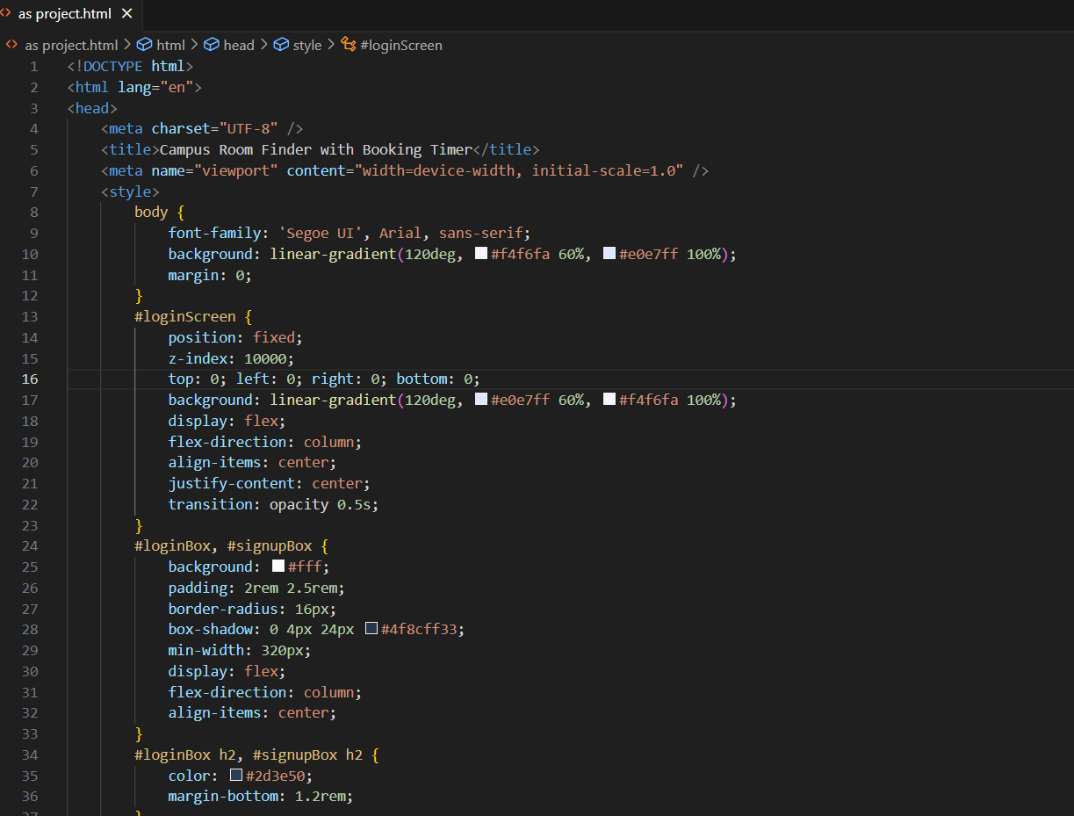
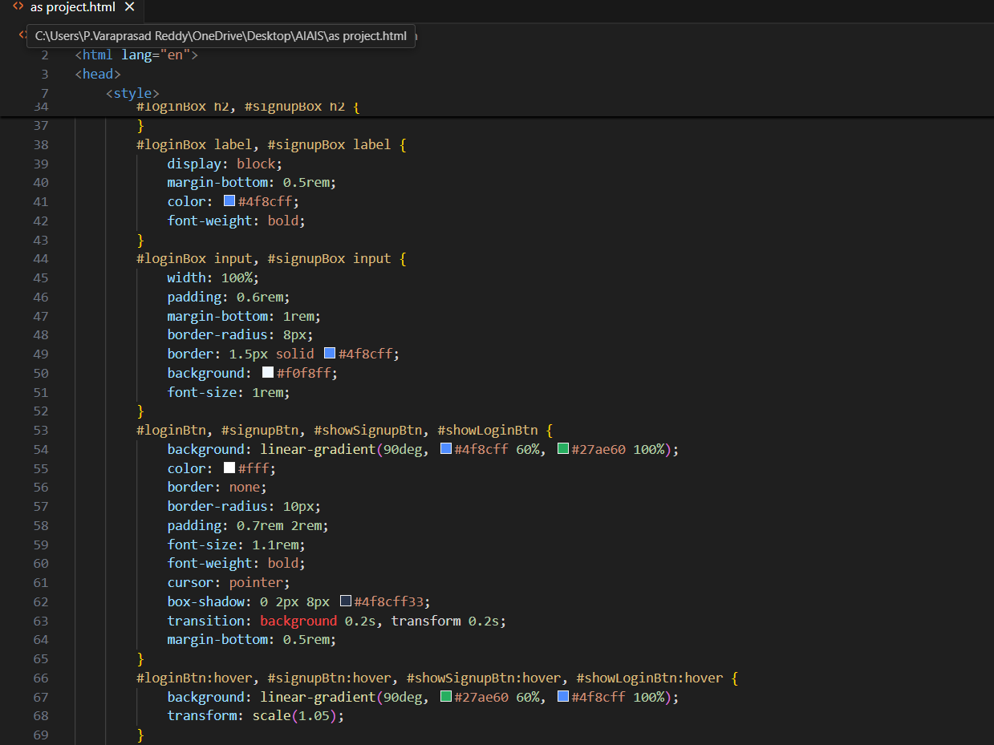
code:

Slide 8
Tools and Software:
1. HTML5: For structuring the web page and UI elements.
2. CSS3: For styling, layout, and responsive design.
3. JavaScript (Vanilla JS): For all interactivity, logic, and DOM manipulation.
4. LocalStorage API: For persistent storage of users, faculty, and room bookings in the browser.
5. No external libraries or frameworks (like React, Angular, Vue, Bootstrap, jQuery) are used.
6. Inline SVG/PNG icons: For UI decoration (via <img> tags with icon URLs).
7. Responsive design via CSS media queries.
All logic (authentication, booking, filtering, timers, etc.) is implemented in plain JavaScript.

Slide 9
***Thank you ***

